Slide 1
Computer Organization & Architecture-15CSE301

Slide 2
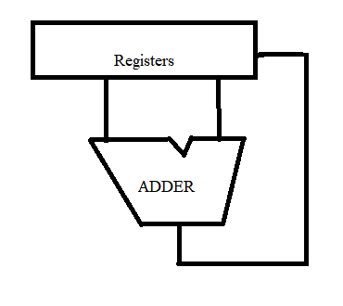
Consider this Case Scenario…
Write a C code to find factorial of a number.
The Instruction Set(ISA) Level
Architectural Level
for(i=1;i<=n;i++)
fact=fact*i;
load/add/store instructions

Slide 3
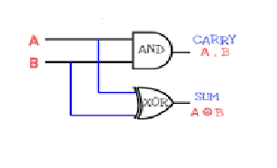

Varied levels of Abstraction……
Digital Electronics-
Logic Level
Transistor Level
Physics/Chemistry
Properties of atoms/electron
Abstraction omits unneeded detail, helps us cope with complexity

Slide 4
What is Computer Architecture & What is Computer Organization?
Architecture is always concerned with what to do?
Organization will take care of how to do?
Architecture is concerned with High level Design-Analysis of what all types of instructions, Addressing Modes, Usage of Registers.
Organization is concerned with Implementation or Building Process.
Architecture carries higher precedence than Organization.
Only after the Design (Architecture), Implementation (Organization) can be done.

Slide 5
Example for Computer Architecture & Computer Organization?
If a calculator is to be built:
Architecture-Division operation
Organization-Implemented as single ‘div’ instruction or repeated ‘sub’ instruction
Organization –Understands design issues or challenges

Slide 6
Comparison for Computer Architecture & Computer Organization?
Computer Architecture | Computer Organization
High level design and feature sescription | Realization of the high level design through Implementation
Connected to InstructionSet, Support for data types, memory consideration etc | More from implementation Aspect is given importatnce -selection of circuit components,peripherals, ALU implemetation etc
Logic wil be given importance | Implementation of the logic is given importance
What to do? | How to do?
Eg: In Calculator-decision to support for Multiplication | Multiplication to be implemented through repeated addition

